Slide 1
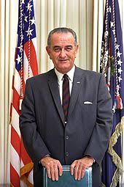
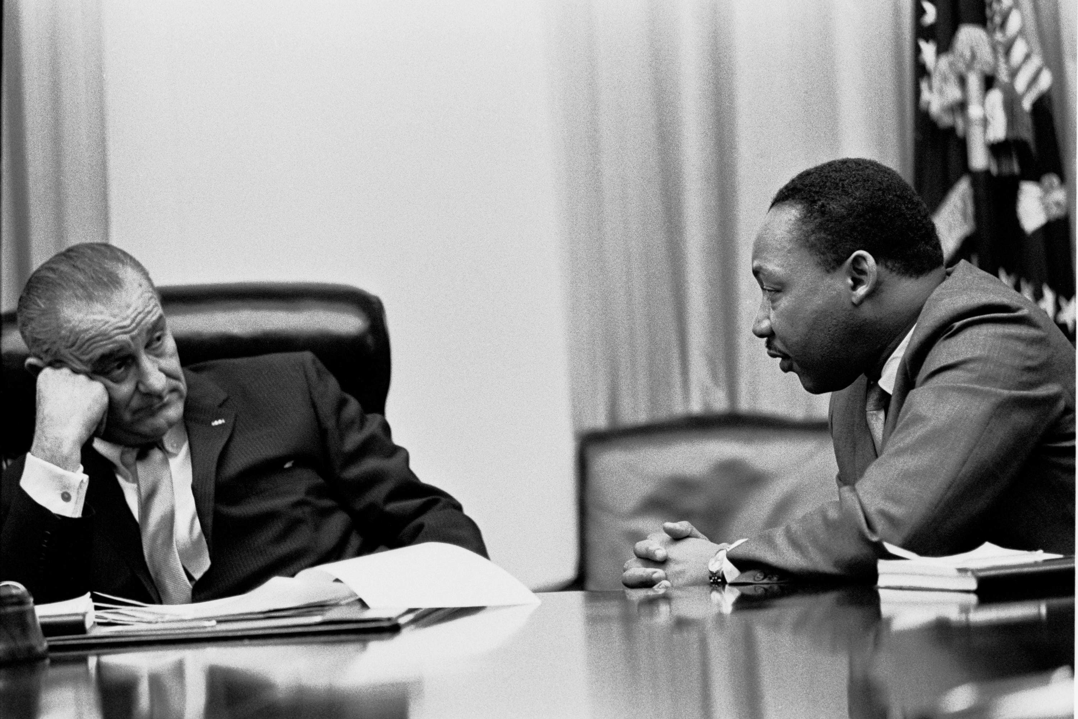
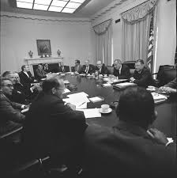
Lyndon B. Johnson & the Great Society
LBJ & MLK
Lyndon B. Johnson,
36th President of USA
1963-69
Johnson’s Cabinet

Slide 2
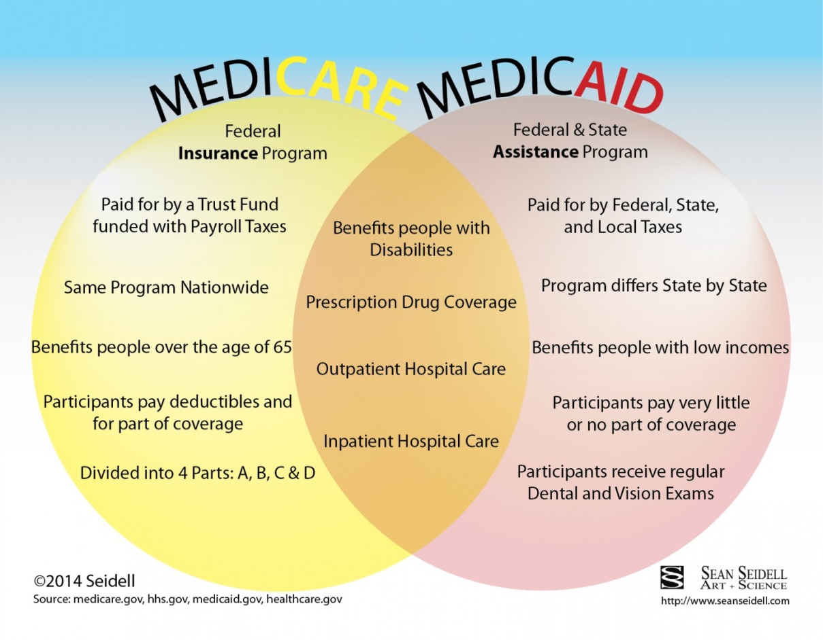
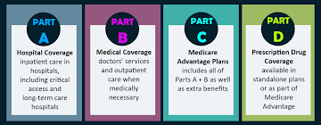
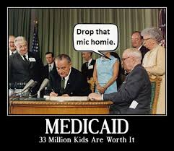
War on Poverty Programs
Medicare, for those over age 65
The differences between Medicare
and Medicaid
Medicaid, for those who are impoverished

Slide 3
War on Poverty Programs
Head Start, first led by Sargent Shriver,
is a program that seeks to bring early
education and day care to those in
impoverished areas
Job Corps’ mission was to bring
employment and experience to
young people in the inner cities

Slide 4
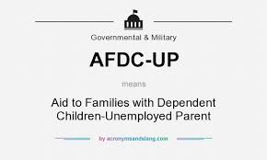
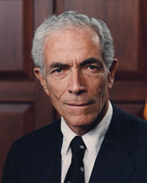
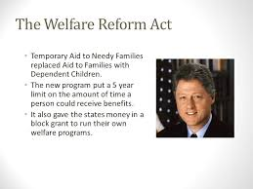
War on Poverty Programs
AFDC: Aid to Families
w/ Dependent Children
Pell Grants, for poor
students to go to
college w/o loans to
pay back
Sen. Claiborne Pell
AFDC replaced during Clinton administration
w/ TANF: Temporary Aid to Needy Families

Slide 5
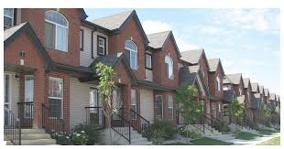
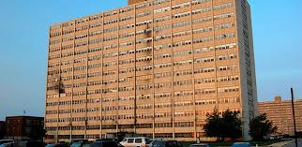
War on Poverty Programs
Dept. of Housing and Urban
Development (HUD)
Cabrini Green Projects, 1967-2010

Slide 6
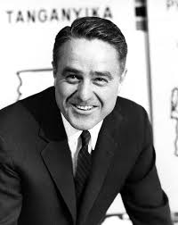
Middle-Class Assistance

Slide 7
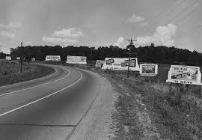
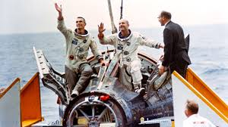
Middle-Class Programs
National Wilderness
Preservation Act
Highway Beautification Act
Space Race
Office of Economic Opportunity

Slide 8
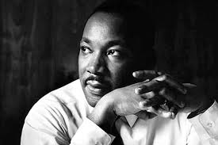
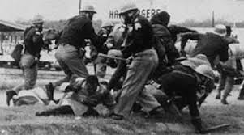
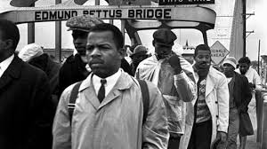
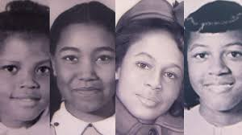
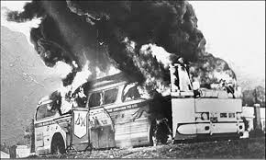
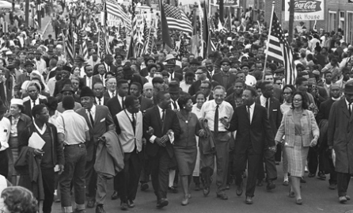
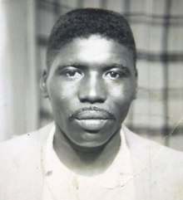
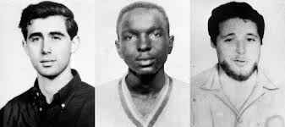
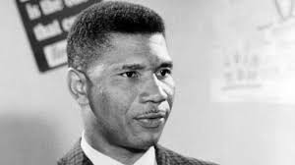
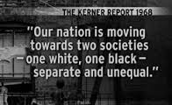
Pro-Civil Rights/Anti-Discrimination Policies
Voting Rights Act of 1965
Civil Rights Act of 1964
Kerner Commission

Slide 9
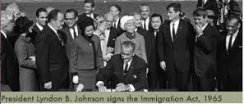
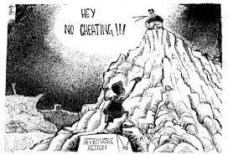
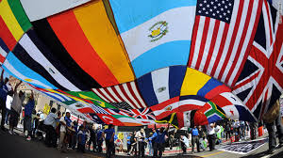
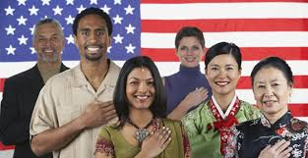
Pro-Civil Rights/Anti-Discrimination Policies
Immigration Act of 1965

